Slide 1

Using Big Data To Solve
Economic and Social Problems
Raj Chetty
Photo Credit: Florida Atlantic University

Slide 2
The American Dream?
Chance that a child born to parents in the bottom fifth of the income distribution reaches the top fifth:

Slide 3
The American Dream?
Chance that a child born to parents in the bottom fifth of the income distribution reaches the top fifth:
USA
Chetty, Hendren, Kline, Saez 2014
7.5%
UK
Blanden and Machin 2008
9.0%
Denmark
Boserup, Kopczuk, and Kreiner 2013
11.7%
Canada
Corak and Heisz 1999
13.5%

Slide 4
The American Dream?
Chance that a child born to parents in the bottom fifth of the income distribution reaches the top fifth:
→ Chances of achieving the “American Dream” are almost
two times higher in Canada than in the U.S.
USA
Chetty, Hendren, Kline, Saez 2014
7.5%
UK
Blanden and Machin 2008
9.0%
Denmark
Boserup, Kopczuk, and Kreiner 2013
11.7%
Canada
Corak and Heisz 1999
13.5%

Slide 5
Why is Upward Mobility Lower in America?
Central policy question: why are children’s chances of escaping poverty so low in America?
  And what can we do to improve their odds…?
Difficult to answer this question based solely on country-level data
  Numerous differences across countries makes it hard to test between alternative explanations
  Problem: only a handful of data points

Slide 6
Theoretical Social Science
Until recently, social scientists have had limited data to study policy questions like this
Social science has therefore been a theoretical field
  Develop mathematical models (economics) or qualitative theories (sociology)
  Use these theories to explain patterns and make policy recommendations, e.g. to improve upward mobility

Slide 7
Theoretical Social Science
Problem: theories untested → five economists often have five different answers to a given question
Leads to a politicization of questions that in principle have scientific answers
  Example: is Obamacare reducing job growth in America?

Slide 8
The Rise of Data and Empirical Evidence
Today, social science is becoming a more empirical field thanks to the growing availability of data
  Test and improve theories using real-world data
  Analogous to natural sciences

Slide 9
Empirical (Data-Based) Articles in Leading Economics Journals, 1983-2011
80%
60%
40%
Percentage of Empirical Articles
38.4%
60.3%
60.0%
72.1%
20%
0%
1983
1993
2003
2011
Year
Source: Hamermesh (JEL 2013)

Slide 10
Social Science in the Age of Big Data
Recent availability of “big data” has accelerated this trend
  Large datasets are starting to transform social science, as they have transformed business
Examples:
  Government data: tax records, Medicare
  Corporate data: Facebook, retailer data
  Unstructured data: Twitter, newspapers

Slide 11
Why is Big Data Transforming Social Science?
Greater reliability than surveys
Ability to measure new variables (e.g., emotions)
Universal coverage → can “zoom in” to subgroups
Large samples → can approximate scientific experiments

Slide 12
Why This Course?
Silicon Valley has been very successful in solving private-sector problems using technology and big data
Goal of this course: show how same skills can be used to address important social and economic problems
  We need more talent in this area given pressing challenges such as rising inequality and global warming
To achieve this goal, provide an introduction to a broad range of topics, methods, and real-world applications

Slide 13
Overview of Topics
Equality of Opportunity
Education
Health
Environment
Criminal Justice and Discrimination
Political Polarization

Slide 14
Overview of Methods
Descriptive Data Analysis
Experiments
Quasi-Experiments
Machine Learning
Stata programming

Slide 15
Methods: Two Types of “Big Data”
Big data can be classified into two types
  “Long” data: many observations relative to variables (e.g., tax records)

Slide 16


Slide 17
Methods: Two Types of “Big Data”
Big data can be classified into two types
  “Long” data: many observations relative to variables (e.g., tax records)
  “Wide” data: few observations relative to variables (e.g. Amazon clicks, newspapers)

Slide 18


Slide 19
Methods: Two Types of “Big Data”
Statistics/computer science has focused on “wide” data
  Main application: prediction
  Example: predicting income to target ads
Social science has focused on “long” data
  Main application: identifying causal effects
  Example: effects of improving schools on income

Slide 20

Lecture 1: Equality of Opportunity
Local Area Differences in Upward Mobility within America
Geographical Variation: Causal Effects of Places or Sorting?
Characteristics of Low vs. High Mobility Areas
Lecture 1 is based primarily on two papers:
  Chetty, Hendren, Kline, Saez. “Where is the Land of Opportunity? The Geography of Intergenerational Mobility in the U.S.” QJE 2014
  Chetty and Hendren. “The Effects of Neighborhoods on Children’s Long-Term Outcomes” 2017a, b

Slide 21
Part 1
Local Area Variation in Upward Mobility
Part 1
Local Area Variation

Slide 22
Differences in Opportunity Across Local Areas
Chetty et al. (2014) use “big data” to measure upward mobility for every metro and rural area in the U.S.
  De-identified tax records on all children born in America between 1980-1982 (10 million children)
Classify children into locations based on where they grew up
Rank children in national income distribution (not local distribution) when computing rates of upward mobility

Slide 23
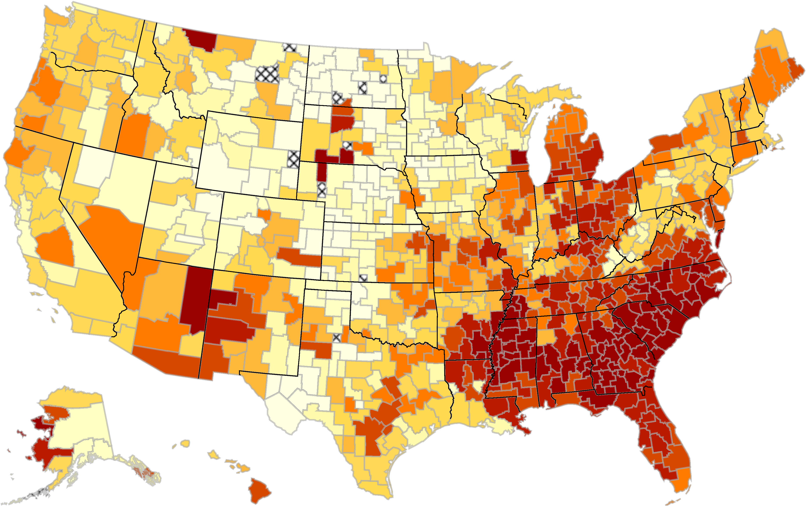
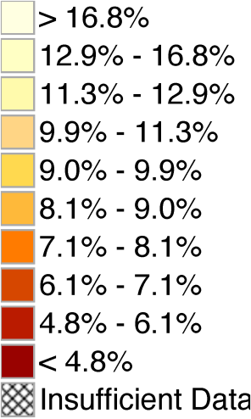
The Geography of Upward Mobility in the United States
Chances of Reaching the Top Fifth Starting from the Bottom Fifth by Metro Area
Minneapolis 8.5%
Chicago
6.5%
New York City 10.5%
San
Jose
12.9%
Washington DC 11.0%
Charlotte 4.4%
Salt Lake City 10.8%
Atlanta 4.5%
Note: Lighter Color = More Upward Mobility
Download Statistics for Your Area at www.equality-of-opportunity.org

Slide 24
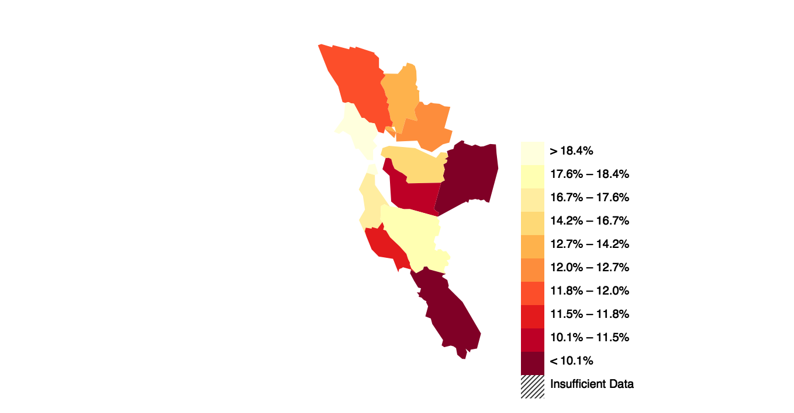
The Geography of Upward Mobility in the Bay Area
Chances of Reaching the Top Fifth Starting from the Bottom Fifth by County
Alameda (Oakland)
11.4%
San Francisco
18.5%
San Mateo
17.4%
Santa Clara
17.7%
Lighter Color = More Upward Mobility
Download Statistics for Your Area at www.equality-of-opportunity.org

Slide 25
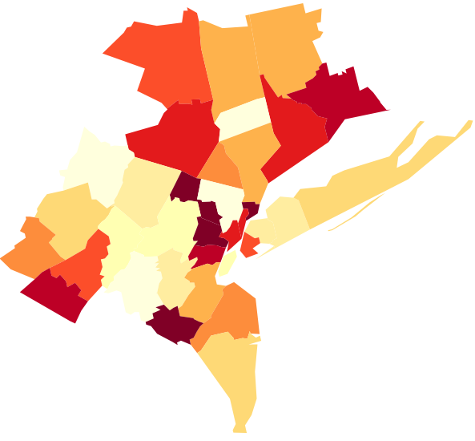
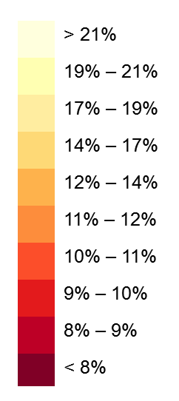
The Geography of Upward Mobility in the New York Area
Chances of Reaching the Top Fifth Starting from the Bottom Fifth by County
Ulster
10.6%
New Haven
9.3%
Bronx
7.3%
Suffolk
16.0%
Monroe
14.1%
Queens
16.8%
Manhattan
9.9%
Brooklyn
10.6%
Ocean
15.1%

Slide 26
Part 1
Local Area Variation in Upward Mobility
Part 2
Causal Effects of Neighborhoods

Slide 27
Causal Effects of Neighborhoods vs. Sorting
Two very different explanations for variation in children’s outcomes across areas:
  Sorting: different people live in different places
  Causal effects: places have a causal effect on upward mobility for a given person

Slide 28
Identifying Causal Effects of Neighborhoods
Ideal experiment: randomly assign children to neighborhoods and compare outcomes in adulthood
We approximate this experiment using a quasi-experimental design
  Study 7 million families who move across counties in observational data
  Key idea: exploit variation in age of child when family moves to identify causal effects of environment
Source: Chetty and Hendren 2017

Slide 29
Earnings Gain from Moving to a Better Neighborhood
100%
80%
60%
40%
20%
Oakland ($30,000)
0%
10
15
20
25
30

Slide 30
Earnings Gain from Moving to a Better Neighborhood
100%
San Francisco ($40,000)
80%
60%
40%
20%
Oakland ($30,000)
0%
10
15
20
25
30

Slide 31
Earnings Gain from Moving to a Better Neighborhood
100%
San Francisco ($40,000)
80%
60%
Move at age 9 → 54% of gain from growing up in San Francisco since birth
Gain from Moving to a Better Area
40%
20%
Oakland ($30,000)
0%
10
15
20
25
30
Age of Child when Parents Move

Slide 32
Earnings Gain from Moving to a Better Neighborhood
100%
San Francisco ($40,000)
80%
60%
Gain from Moving to a Better Area
40%
20%
Oakland ($30,000)
0%
10
15
20
25
30
Age of Child when Parents Move

Slide 33
Earnings Gain from Moving to a Better Neighborhood
100%
San Francisco ($40,000)
80%
60%
Gain from Moving to a Better Area
40%
20%
Oakland ($30,000)
0%
10
15
20
25
30
Age of Child when Parents Move

Slide 34
Identifying Causal Effects of Neighborhoods
Key assumption: timing of moves to a better/worse area unrelated to other determinants of child’s outcomes
This assumption might not hold for two reasons:
  Parents who move to good areas when their children are young might be different from those who move later
  Moving may be related to other factors (e.g., change in parents’ job) that affect children directly

Slide 35
Identifying Causal Effects of Neighborhoods
Two approaches to evaluating validity of this assumption:
  Compare siblings’ outcomes to control for family effects

Slide 36
Identifying Causal Effects of Neighborhoods
Two approaches to evaluating validity of this assumption:
  Compare siblings’ outcomes to control for family effects
  Use differences in neighborhood effects across subgroups to implement “placebo” tests
    Ex: some places (e.g., low-crime areas) have better outcomes for boys than girls
    Move to a place where boys have high earnings → son improves in proportion to exposure but daughter does not

Slide 37
Causal Effects of Neighborhoods: Summary
Key lesson of this section: 70-80% of the variation in children’s outcomes across areas is due to causal effects
This result has refocused public discussion on improving upward mobility in America to a local level

Slide 38
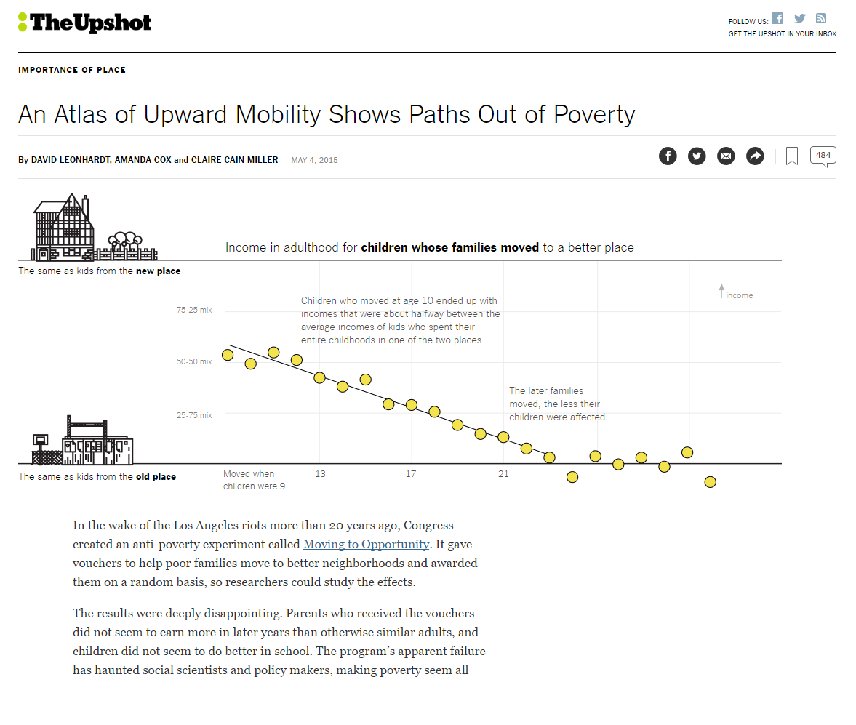

Slide 39
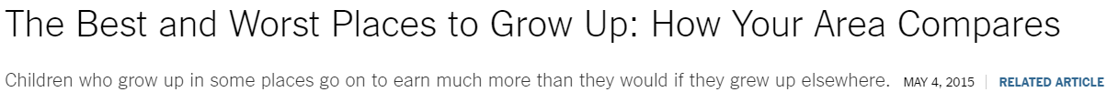
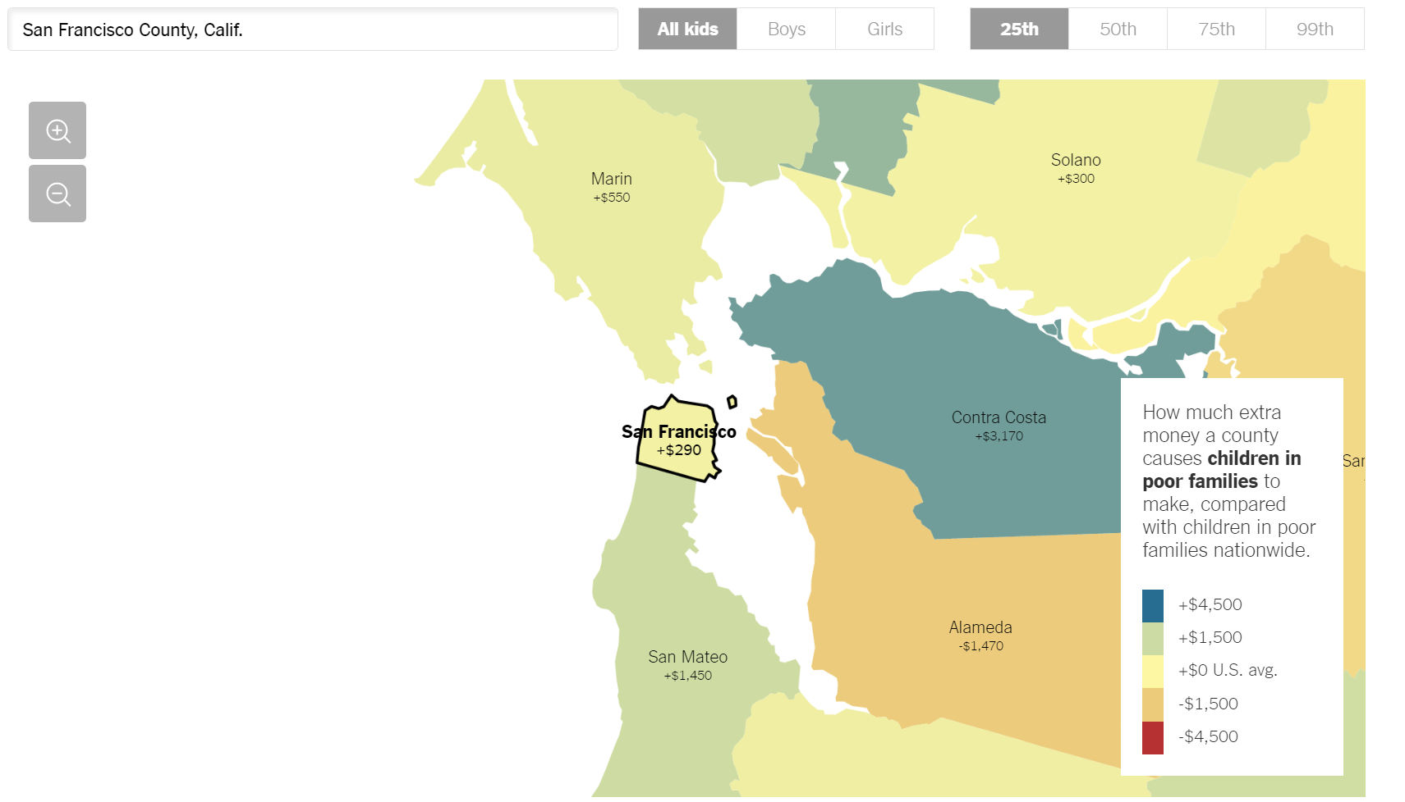
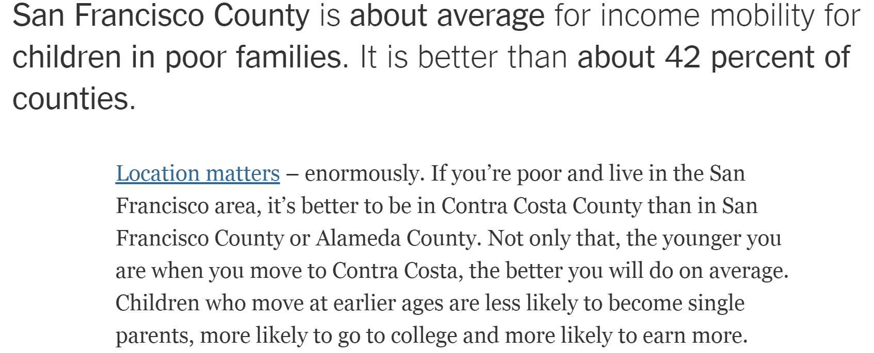

Slide 40
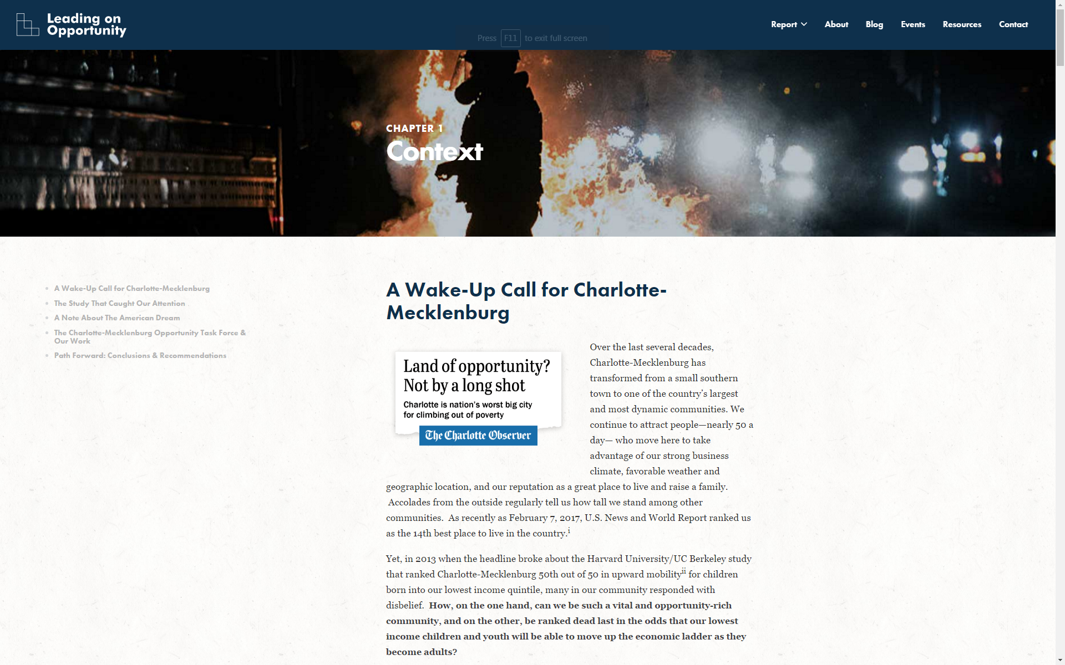

Slide 41
Part 1
Local Area Variation in Upward Mobility
Part 3
Characteristics of High-Mobility Areas

Slide 42
Why Does Upward Mobility Differ Across Areas?
Why do some places produce much better outcomes for disadvantaged children than others?
Begin by characterizing the features of areas with high rates of upward mobility

Slide 43
Five Strongest Correlates of Upward Mobility
Segregation
  Greater racial and income segregation associated with lower levels of mobility

Slide 44
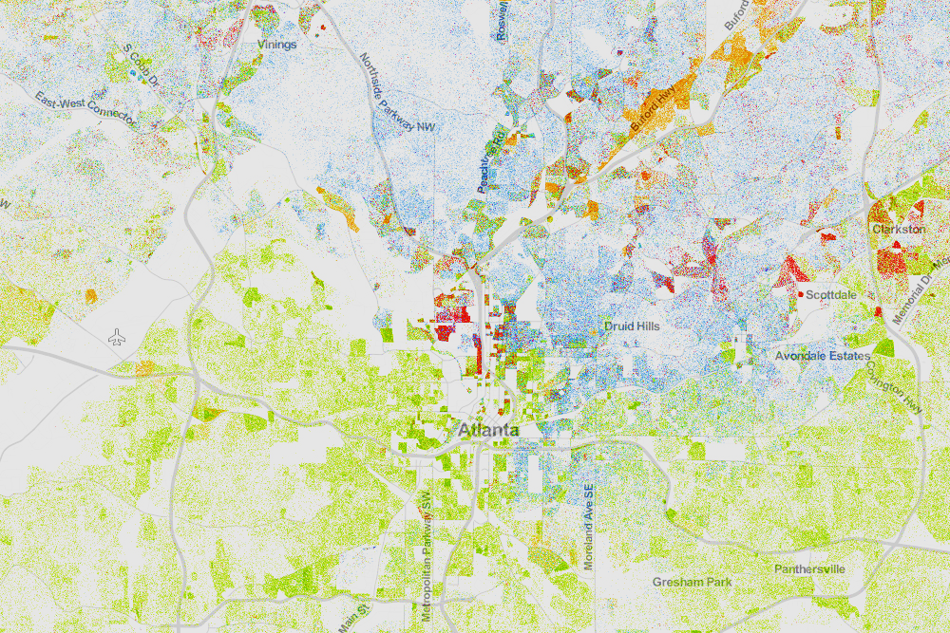
Racial Segregation in Atlanta
Whites (blue), Blacks (green), Asians (red), Hispanics (orange)
Source: Cable (2013) based on Census 2010 data

Slide 45
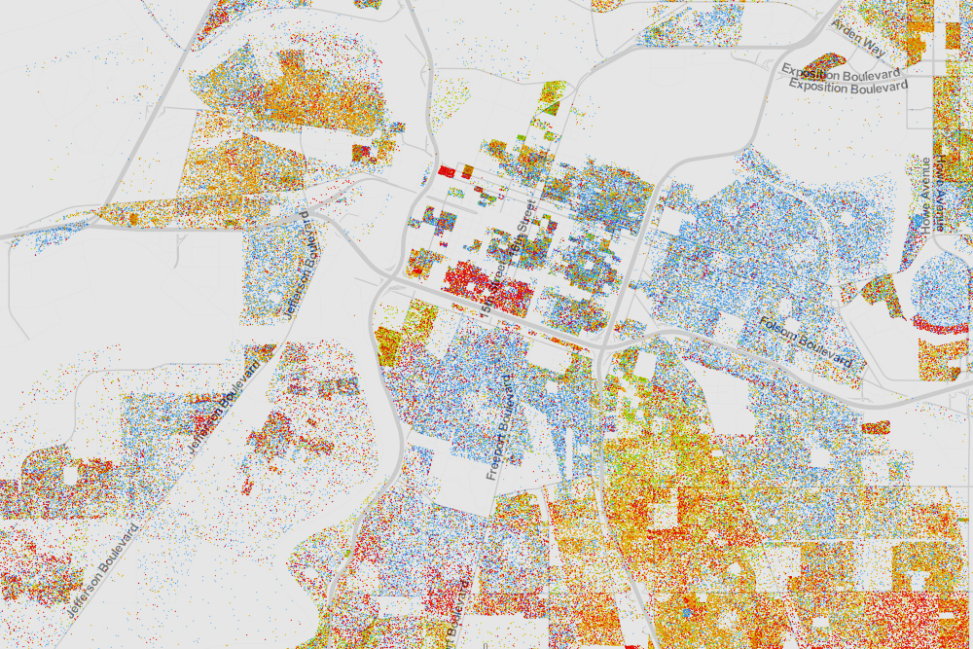
Racial Segregation in Sacramento
Whites (blue), Blacks (green), Asians (red), Hispanics (orange)
Source: Cable (2013) based on Census 2010 data

Slide 46
Five Strongest Correlates of Upward Mobility
Segregation
Income Inequality
  Places with smaller middle class have much less mobility

Slide 47
Five Strongest Correlates of Upward Mobility
Segregation
Income Inequality
School Quality
  Higher expenditure, smaller classes, higher test scores correlated with more mobility

Slide 48
Five Strongest Correlates of Upward Mobility
Segregation
Income Inequality
School Quality
Family Structure
  Areas with more single parents have much lower mobility
  Strong correlation even for kids whose own parents are married

Slide 49
Five Strongest Correlates of Upward Mobility
Segregation
Income Inequality
School Quality
Family Structure
Social Capital
  “It takes a village to raise a child”
  Putnam (1995): “Bowling Alone”

